Slide 1
Signal Extraction from Instantaneous Lacquer Discs
Robert Cowlin
Notes:
In this presentation I am going to describe an approach to lacquer disc digitisation that aims to extract as much of the original signal from the disc as possible, whilst minimising sonic intrusions in the analogue domain through the implementation of a thorough cleaning regimen and precise selection of the playback stylus.

Slide 2
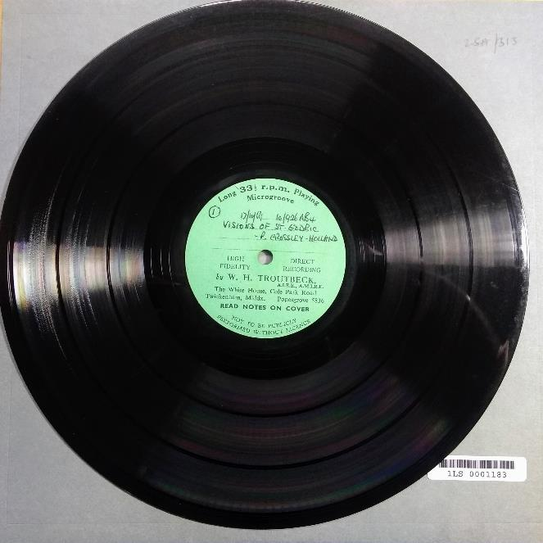
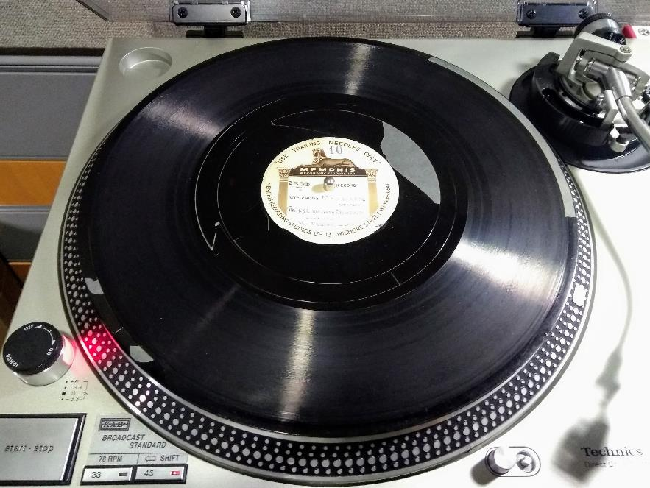
Introduction to Lacquer Discs
Notes:
In 1934, Cecil Watts, “longing for a playback recording machine that would give an immediate playback to rehearsing musicians”, “created a system of economical, efficient recording using an aluminium-based cellulose nitrate lacquer-coated disc that enabled playback directly after recording. The advantage of the Watts system was that, while the coating was soft enough to enable the recording stylus to cut, it was durable enough to withstand repeated playbacks … The system was widely used through the 1930s and beyond”, and is still in use today, comprising the first step in the manufacture of vinyl records.
Instantaneous discs “consist of a strong and stiff base (aluminium or glass, occasionally zinc) covered with a layer of cellulose nitrate lacquer, coloured dark to improve observation of the cutting process. The cutting properties are controlled by the addition of softening agents, such as castor oil or camphor”.
The Watts nitrate system “was gradually adopted by the whole disc-recording industry to replace wax, which was more expensive and too soft to be played back; the changeover was complete by 1950” . Due to their instantaneous nature, these discs regularly contain unique or rare recordings. For this reason alone, they constitute a preservation priority. However, the format is also particularly unstable, thus elevating it to the status of high priority at the British Library Sound Archive.
The lacquer layer contracts continuously over time “due to evaporation or migration of the softening agent”, resulting in the delamination of the recorded layer from the metal substrate. The shrinking lacquer eventually cracks and flakes off causing the inevitable and irreversible loss of the sound carrying layer. Failure can also manifest itself in the form of a “dried-out … crazed surface that may be unplayable”.

Slide 3
Also known as…
Laminate disc
Transcription disc
Instantaneous disc
"Acetate" disc
Direct-cut disc.
Notes:
Watts’ “development accompanied rivals such as “gelatine”, “Simplat,” “Permarec,” and others, but these were all aimed at amateur markets. Only “nitrate” was adopted by professionals, because (when new) it had lower background-noise than any other analogue medium”.
Industry professionals and hobbyists alike use various terms to describe these discs. For the purposes of this presentation I am almost exclusively going to focus on aluminium-based discs coated in a lacquer of cellulose nitrate which is modulated by a cutting stylus. The British Library’s collection of lacquer discs does extend to include cardboard and glass based discs, some of which are coated in gelatine.

Slide 4
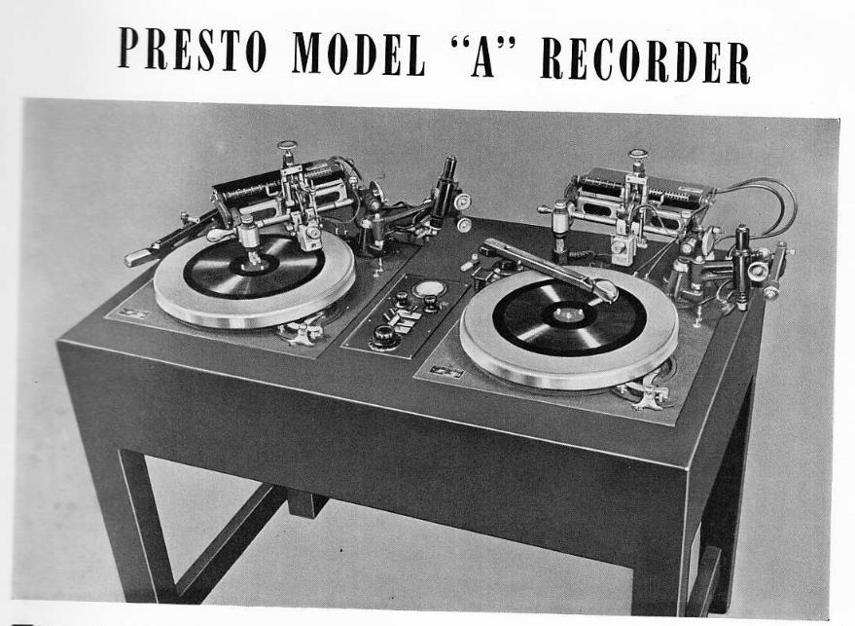
Format Characteristics (c.1940)
Frequency response: 50 Hz – 8 kHz (dictated by cutting head)
Signal-to-noise ratio: >50 dB
Sizes: 5”, 7”, 10”, 12”, 13”, 14”, 15”, 16”.
Notes:
Concurrent to Watts’ invention, the Presto Recording Corporation of New York introduced its Presto Disc recording system. Advertised as “the first cellulose coated disc for instantaneous recording”, the corporation’s 1940 catalogue contains some specifications for its iteration of the cellulose-based disc. Presto claimed that “surface noise on a well cut Presto disc is inaudible for about six plays. Thereafter it increases slightly with wear but is lower than commercial phonograph record noise for at least 100 plays. Over 1,000 useful plays can be obtained” . The cutting head in the corporation’s top of the line Model “A” Recorder is quoted as having a frequency response of “50 to 8,000 cycles +/- 2 dB” and a noise level of “50 dB below maximum useful sound level reproduced from the recordings”.
Lacquer discs come in a multitude of sizes. The British Library’s collection consists of discs ranging from 5” to 16” in diameter.
Discs from the birth of the format to about 1950 tend to have been cut with coarse groove equipment, whilst post-1950 the cutting style gravitates towards microgroove. However, as the format spans professional recording studios, semi-professional cutting services, and hobbyists it is impossible to state anything concrete regarding groove type, especially whilst 78s and LPs shared the market. One does however observe an overall improving of the format’s capabilities concurrent with advances in disc cutting technology, especially with the widespread adoption of microgroove by the late 1950s.

Slide 5
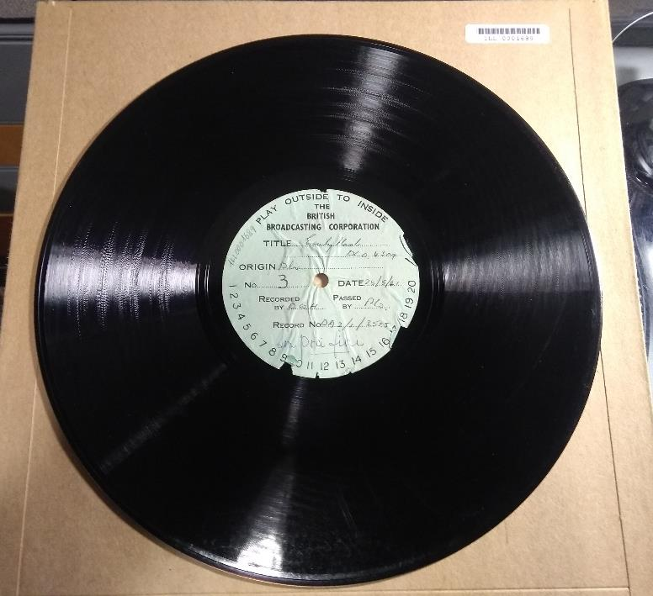
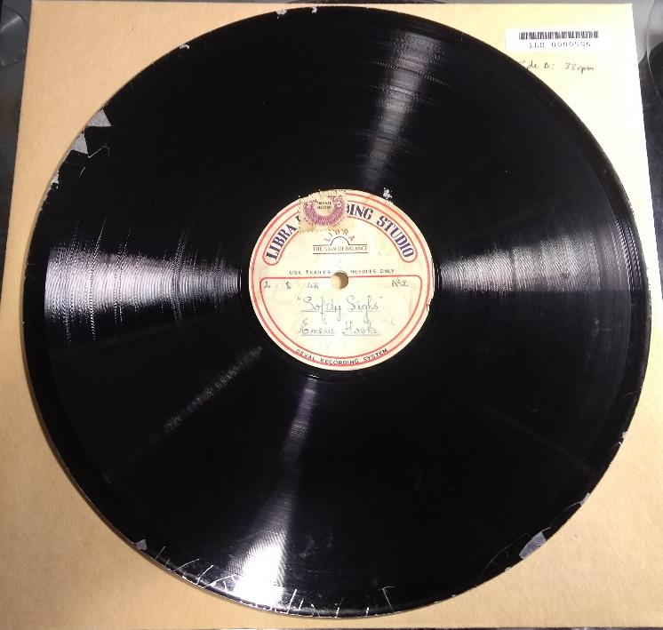
Emelie Hooke lacquer disc collection
Notes:
The bulk of examples that I will be featuring come from a collection of seventeen instantaneous recordings of the Australian soprano, Emelie Hooke. Spanning 1941-1956, the collection consists of seven recordings made by the BBC in 1941, as well as lacquers cut at Levy’s Sound Studios presumably from radio broadcasts, amongst others.
All of the discs are 12” in diameter, apart from two 10” examples from 1948. The condition of the discs is mostly very good for their age. They have no tracking defects, however some are exhibiting the initial stages of edge delamination. A visual inspection indicates that they were all cut using coarse groove styli, including the one dated 1956. They all play at 78 RPM.

Slide 6
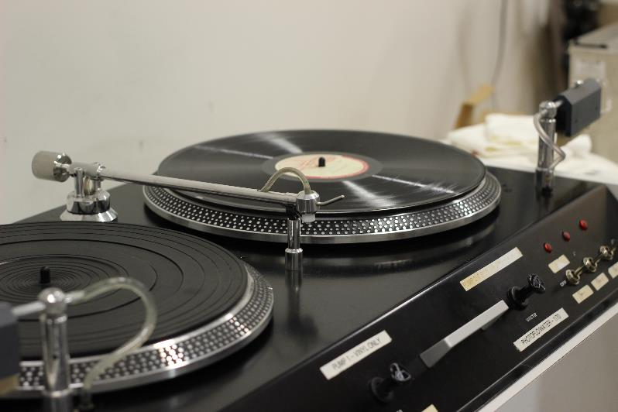
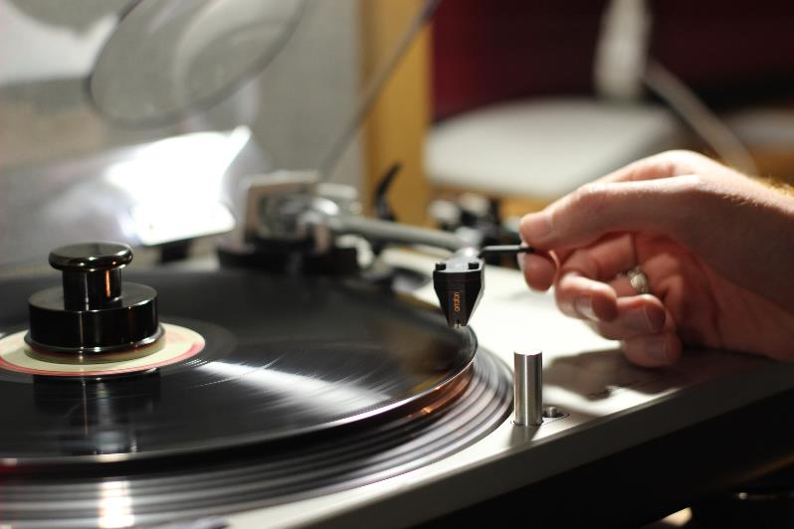
Transfer Workflow
Notes:
The transfer workflow consists of three broad sections: preparation, migration, and capture.
Preparation consists of any physical conservation applied to the disc prior to playback. In the case of lacquers this generally includes: washing and brushing the disc in the aid of dust and dirt elimination, as well as removing mould and any exuded plasticiser from the disc.
Migration is the playback stage and includes the setting of speed, equalisation, and stylus type, as well as general turntable preparation and configuration of the analogue-to-digital converter.
Capture involves work performed at the computer into which the ADC is connected.
I’d now like to investigate each of these stages in greater detail.

Slide 7
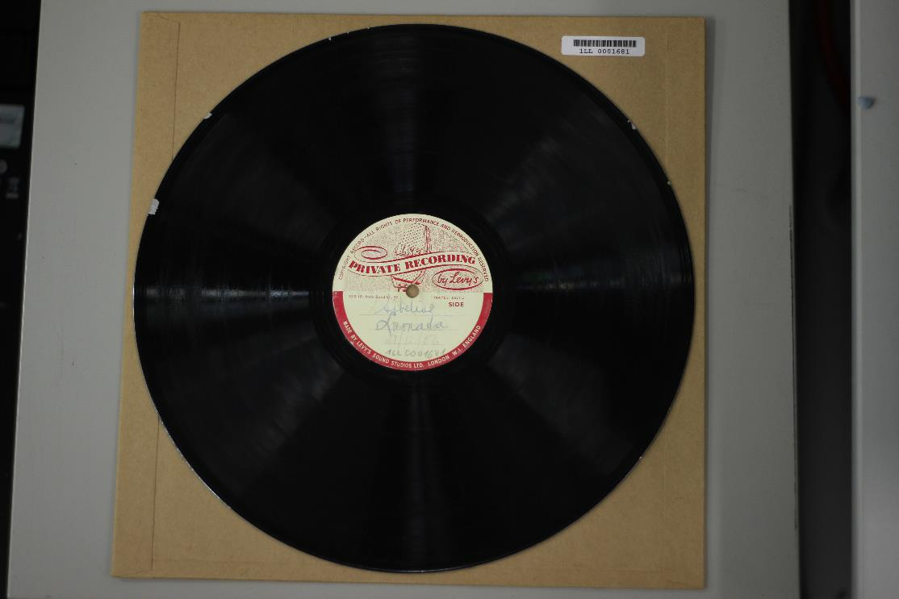
Preparation
Notes:
Inspect the disc and label. Consider any damage or risk of damage that could occur during the transfer process. Also take this opportunity to read the label, in particular check for speed and date annotations that may assist in the later selection of a stylus and playback EQ.
This disc is showing early signs of edge delamination, revealing the aluminium substrate beneath the nitrate. It is dated 1956.
It is safe to wet-clean lacquer discs that are coated in cellulose nitrate with a metal substrate. If the disc is in the advanced stages of delamination, whereby the lacquer is literally hanging from the disc, I would not recommend attempting to wet clean it. However, if the lacquer is intact, or mostly intact as is the case with this disc then it is safe to proceed with a cautious wet clean.
First, we must confirm that the disc has a metal base and isn't card or glass. If the disc is lightweight, slightly flexible, and rings like aluminium then that’s good. If the disc is heavy, and semi-translucent when light is projected through, it is likely to be glass based. Card discs are lighter than aluminium and they have a consistency similar to that of a cardboard record sleeve. The physical instability of cardboard bases often results in uneven or cracked surfaces while the fragility of glass bases often results in broken discs.
Card of course cannot be wet cleaned, and glass discs are too likely to crack during the cleaning process. However, in the case of the Hooke collection all of the discs have a metal base so it is okay to continue to the next step.
The next step is to confirm that the disc is not coated in gelatine. Gelatine reacts badly when exposed to water so perform a patch test by placing a blob of water on the run-out groove. If the coating is gelatine it will immediately react, bubble, and crack. If that’s the case, the wet clean should be abandoned.
Assuming the disc consists of a metal base coated in a lacquer of cellulose nitrate it is safe to continue with care.

Slide 8
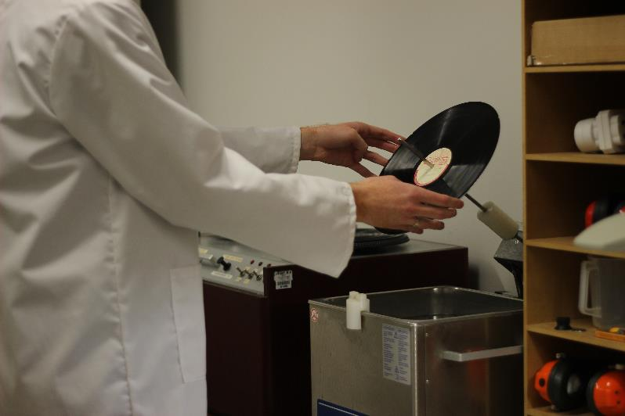
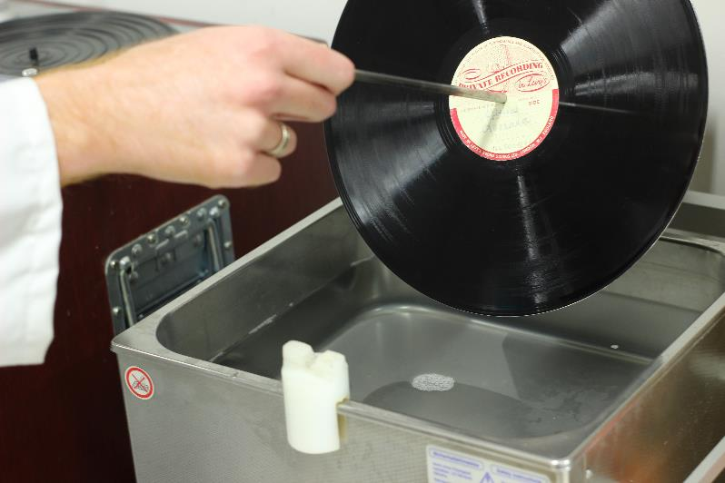
Cleaning
Notes:
This procedure consists of two cleaning stages.
First, the disc is lowered into an ultrasonic bath, filled with water and photographic wetting agent, and exposed to a 35 kHz ultrasonic frequency for five minutes. The disc turns at 1 RPM on a spindle and is submerged up to the runout groove to protect the label from water damage. During this cycle, tiny bubbles implode against the disc, scouring out the tiny particles trapped in the grooves.
Inclusion of wetting agent in the ultrasonic solution is important as it breaks the water’s surface tension. Without it the cavitation process can be drastically compromised.

Slide 9
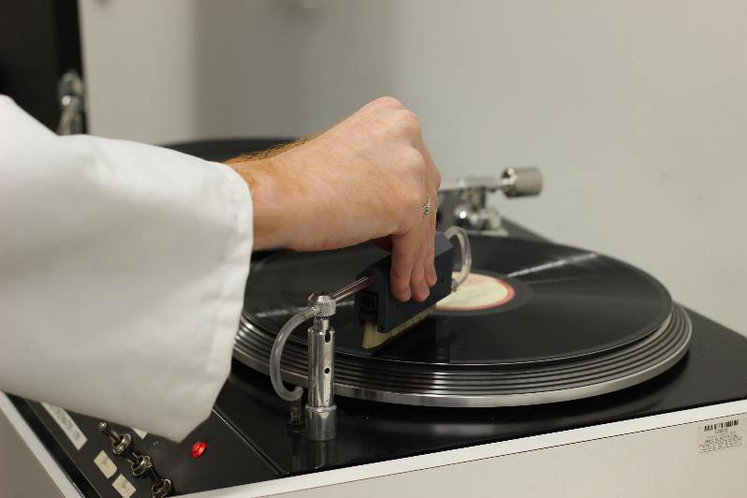
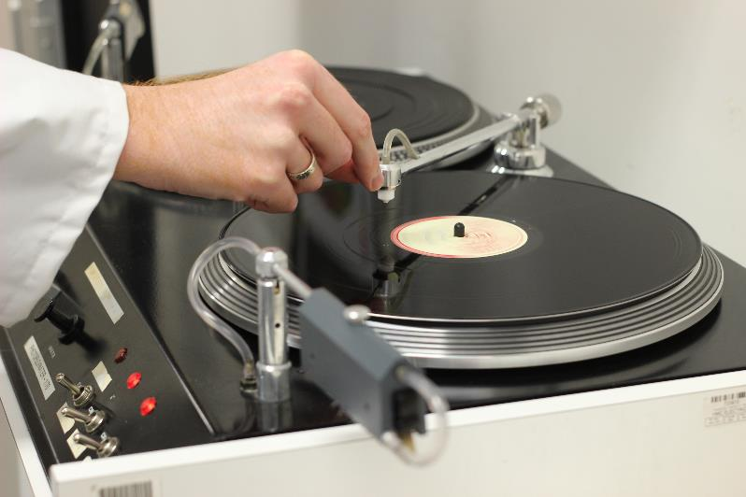
Notes:
Upon completion of the ultrasonic clean, transpose the wet disc onto a string type record cleaning machine (such as the Keith Monks shown here) and perform a pure water rinse. The objective here is to remove any residue from the disc that may remain from the ultrasonic bath (such as that of the wetting agent). Deionised water is released through the machine’s brush and coats the record before being sucked up by the vacuum nozzle.
I would advise against using consumer grade “wand” type vacuum machines when dealing with lacquer discs. The strength of the vacuum, combined with the large arm coverage over the disc, could result in delamination.

Slide 10
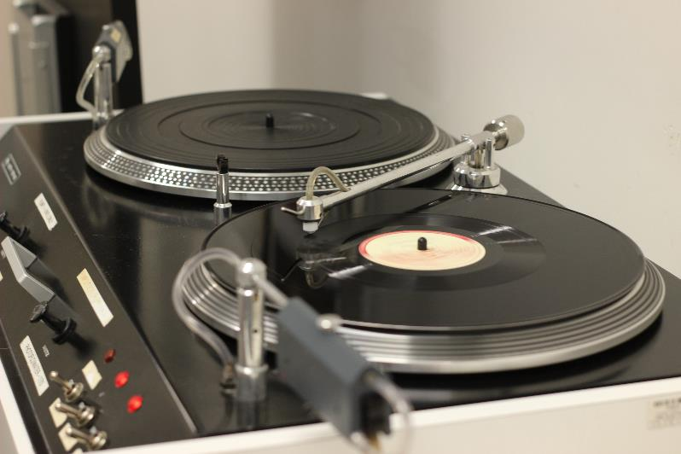
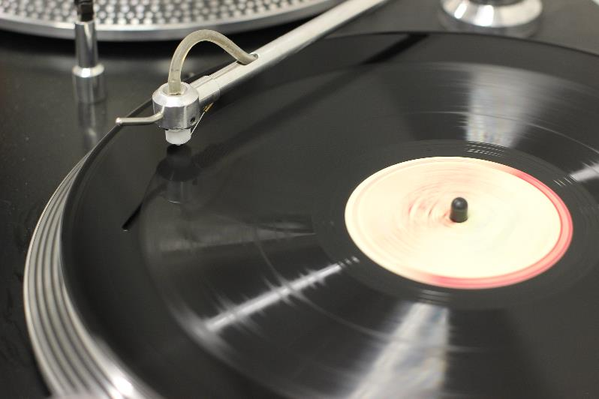
Notes:
The vacuum nozzle tracks the disc from the centre out. A thread travels up the arm tube, out through the nozzle – sponging the grooves – and back down the arm where it is deposited into a waste jar along with the vacuumed liquid.

Slide 11
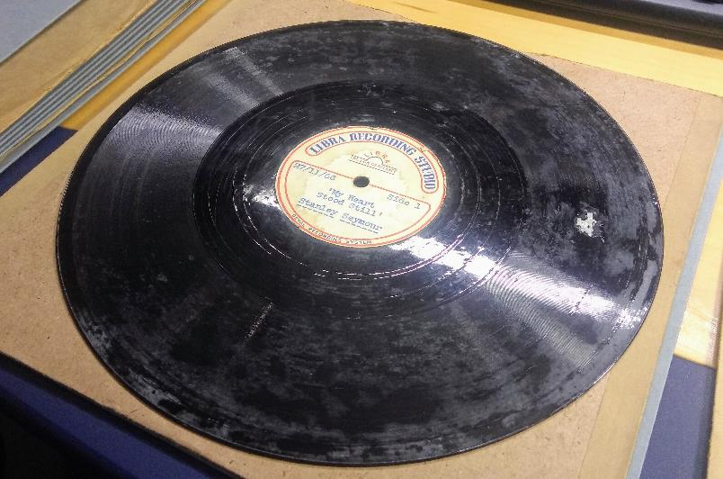
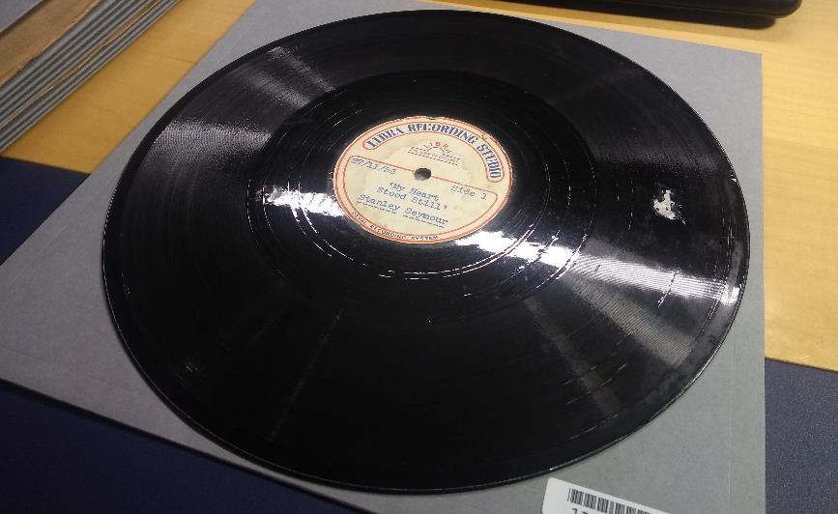

Before and After…
Notes:
Lacquer discs can become inflicted with mould, dirt, dust, and other conventional contaminants that one would generally associate with grooved media. However, a failure that is specific to lacquers is that, as they age, some formulas exude a waxy substance, mostly palmitic and stearic acids, as the castor oil plasticiser breaks down. This presents itself in the form of a soapy feeling white exudate that covers the surface of the disc.
The cleaning regimen outlined previously will remove the exuded plasticiser, leaving a surface free of aberrations. In the absence of an ultrasonic bath, ammonia can be used to break down the fatty acids of the exudate without harming the lacquer coating.
They can also become impacted with grit due to improper storage. Indeed, many of the lacquers we receive come in poor quality torn sleeves. It is important to clean these discs in an ultrasonic bath as a brush based approach will only push the detritus further into the grooves.
AUDIO SAMPLE – JULIE ANDREWS.
I should add here that alcohol will damage lacquer discs.

Slide 12
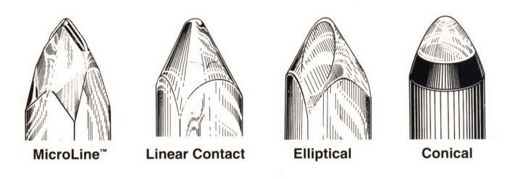
Choosing the Stylus
Notes:
Firstly, a brief history of stylus development in the microgroove era. You’ll see how this relates to coarse groove lacquers shortly.
When we identify styli, we speak of the shape of the stylus tip (also known as the stylus profile), and the stylus width as it sits in the groove front-on.
Conical/spherical is the originally specified stylus profile for vinyl.
Elliptical invented in 1966.
Linear contact in 1973.
MicroLine in 1983.
Stylus width is generally expressed in mil. Mil is equal to a thousandth of an inch: 1 mil = 0.001 inch = 25.4 µm (microns).

Slide 13
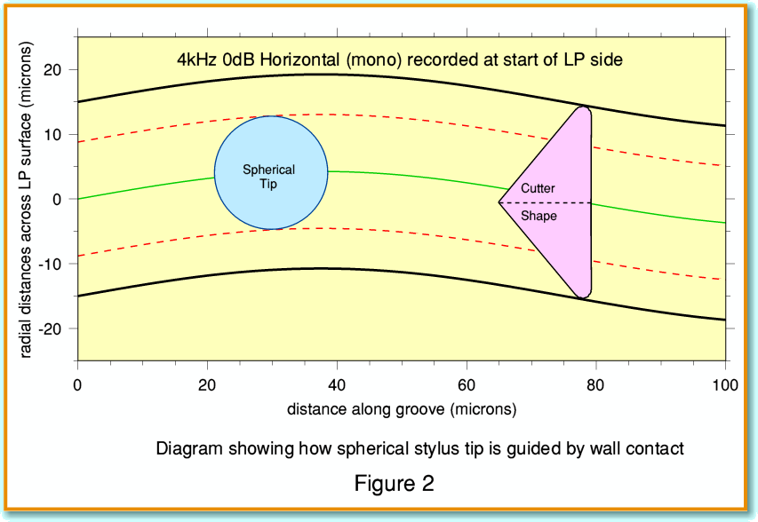
Jim Lesurf, Hi-Fi News
Notes:
Jim Lesurf, Hi-Fi News.

Slide 14
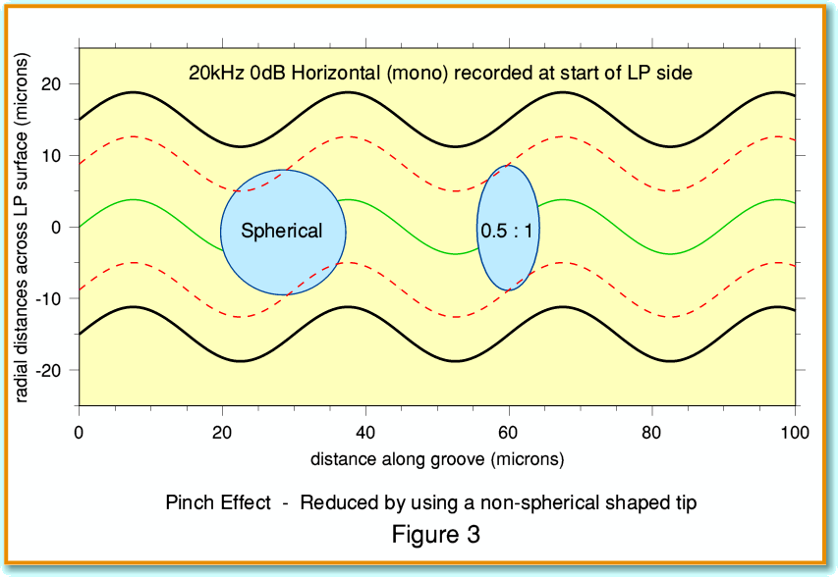
Notes:
“A round stylus cannot reproduce, in a fully satisfactory manner, signals of relatively high frequencies recorded in the form of small waveforms in the groove walls”.
To overcome this disadvantage an elliptical stylus was invented by Joseph Grado. This elliptical stylus has a shape produced by grinding the front and rear sides of a round stylus thereby producing the cross section of an elliptical shape … When an elliptical stylus is placed in a record groove, the reduction in the tip’s minor radius results in the satisfactory reproduction of relatively high frequencies.

Slide 15
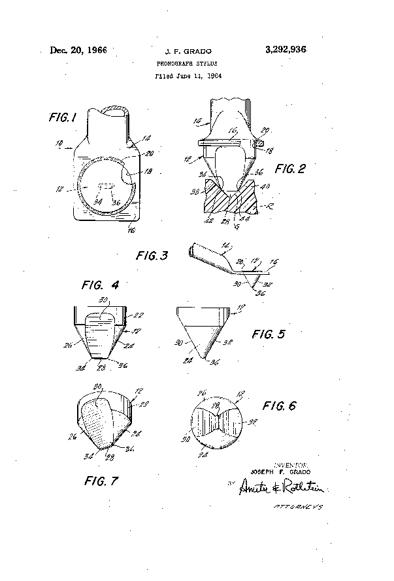
Notes:
Here we have the Grado patent for their elliptical stylus.
The downside to this design, is that in cutting an elliptical tip, the styli’s major radius also becomes small. Consequently, the elliptical stylus can easily bite into the groove walls leading to record damage after several uses and playback distortion.
Because the contact area is reduced, the amount of pressure applied to the grooves is increases.

Slide 16
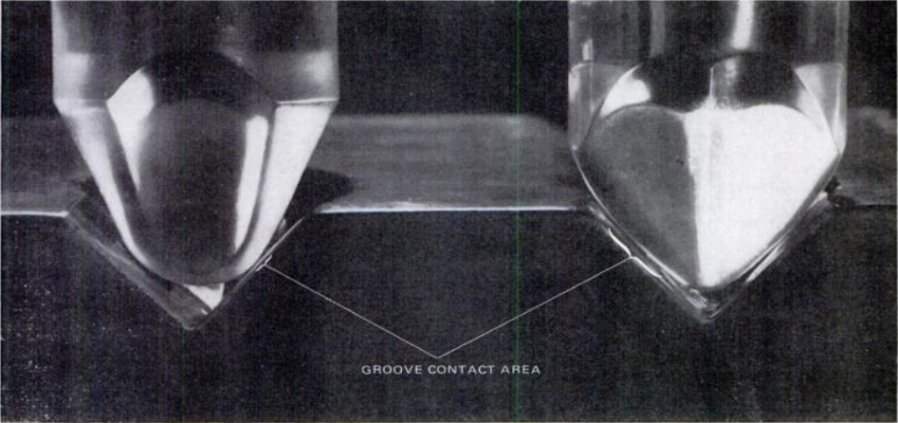
Notes:
In the early 1970s four-channel quadraphonic systems for phonograph records were introduced. One such example, Quadradisc or Compatible Discrete 4 (CD-4), was created by JVC and RCA in 1971.
On these discs, a 30 kHz carrier signal was recorded on each groove wall that aided in the decoding of the rear channel information. Consequently, the need arose for a stylus capable of accurately tracking such fine groove modulations without causing wear. Enter the Shibata line contact stylus!
Conventional elliptical styli have a minor radius of 0.3 mil and a major radius of 0.7 mil. The aim of the Shibata styli’s inventor was to create a tip that possessed an even finer minor radius of 0.2 mil, for the accurate tracking of ultrasonic frequencies, but had a larger major radius (of 2-3 mil), thus increasing the styli’s contact area preventing groove wear and prolonging the life of the disc.
In this illustration we can see the elliptical styli’s limited contact area of the groove on the left, versus the Shibata’s greater contact area owing to its increased width as seen from the front.
We now had a stylus capable of accurately tracking frequencies all the way up to 30 kHz whilst preventing groove wear by contacting a large area of the groove. The consequence of this for conventional LP playback was the elimination of sibilant and inner groove distortion, as well as the revival of previously worn records. The wider stylus could read the groove wall above and below a previously worn area thus contacting unworn parts of the groove resulting in like-new playback.

Slide 17
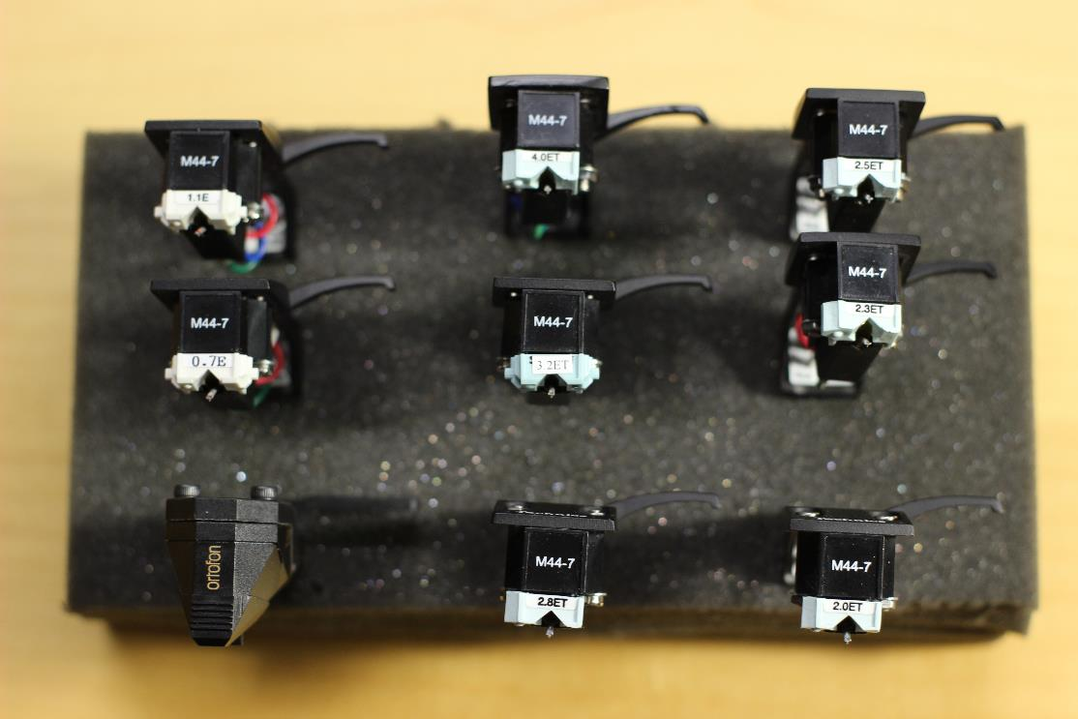
Coarse groove styli
Notes:
No real standards relating to groove or stylus width were agreed upon during the coarse groove era. Consequently, the British Library Sound Archive possesses an array of wide styli for the playback of coarse groove discs. There are two profiles, conical and truncated elliptical. The latter being “a modern development only made by specialist manufacturers. It’s an ‘elliptical’ shape with the tip rounded off, or truncated, so it will always be driven by the groove walls and never the bottom”.
You’ll remember I mentioned that cellulose nitrate had a lower background-noise than any other analogue medium. When we transfer coarse groove discs made from shellac it is necessary to select a stylus width that produces the minimum amount of surface noise. Whilst clicks and crackles can be alleviated in the digital domain without negatively effecting the sound, high levels of surface noise are difficult to tame digitally as the noise becomes embedded in the recorded signal and attempts at removing it result in a loss of fidelity. Consequently the emphasis is on finding a stylus that plays quietly in the groove, sometimes at the expense of clicks and crackle. If one places a very small stylus on a coarse groove shellac disc the result is very high surface noise because the stylus has fallen too far down the groove and is picking up more noise than signal. However, this issue does not exist to the same extent with nitrate. Yes, it possesses its own array of aberrations but these tend to be caused by damage from cracked surfaces or worn grooves. Nitrate’s low background noise permits the selection of a finer stylus capable of reading unworn portions of the groove without worrying too much about increased surface noise, therefore allowing the transfer engineer to focus on click and crackle reduction in the analogue playback domain without having to worry too much about increases in surface noise.
It is therefore possible (with some luck) to play coarse groove lacquer discs with microgroove styli. The result is a playback that is relatively free from distortion and groove wear, with dramatically reduced clicks and noise.
PLAY FILE. 3 mil Vs line contact shibata.

Slide 18
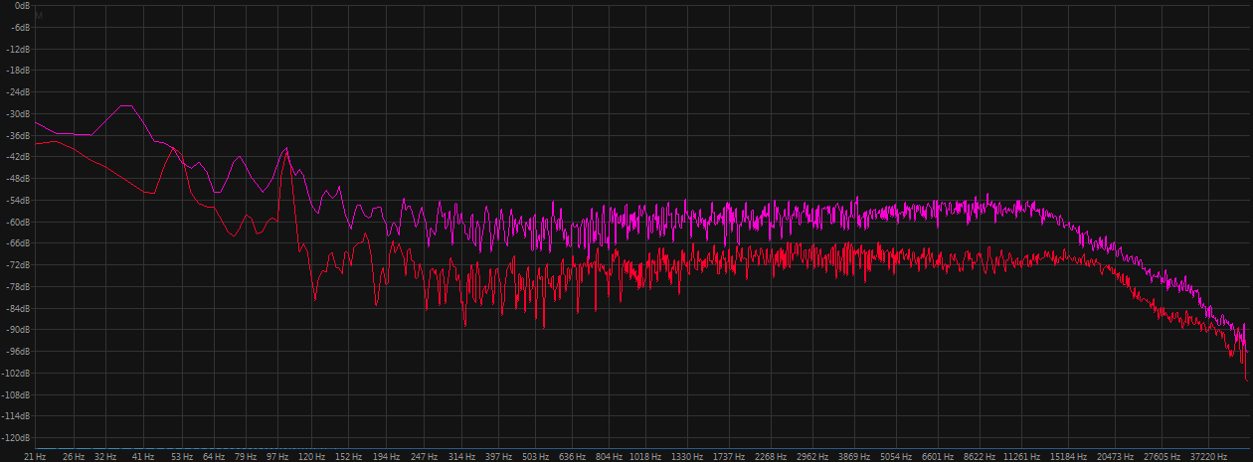
Selecting a stylus without wearing out the disc…
Notes:
It is not always possible to play coarse groove lacquers with a microgroove stylus. In the case of the Emilie Hooke collection, two-thirds responded well to microgroove styli.
Sometimes the grooves are simply too wide and the stylus falls to the bottom. In these instances the sound is riddled with low level distortion so it is necessary to use a coarse groove stylus in order to obtain a satisfactory transfer. There are many downsides to using these less sophisticated styli, in particular they pick up a lot of clicks caused by riding closer to the disc’s surface.
With them comes the added risk of premature groove wear. The task therefore becomes one of choosing a stylus that exhibits the least surface noise whilst avoiding repeatedly auditioning portions of the disc in order to find the right stylus.
The solution is to play the runout groove with a variety of stylus widths until you find one that produces the quietest surface noise. A spectrometer can be useful here, as the engineer can take screenshots of the various styli playing in order to figure out which one is quietest.
Play audio sample.

Slide 19
Equalisation
Peter Copland, Manual of Analogue Audio Restoration Techniques
Notes:
One should be able to get a reasonable idea of playback equalisation based on research prior to transfer and experience of contemporaneous discs. However, it’s perfectly likely that the chosen playback curve might not sound quite right upon listening so this is something that can be tweaked whilst auditioning the disc prior to final capture. Sometimes, transferring the disc with no EQ (i.e. flat) and postponing its application to a future date is the best approach.
I won’t go into too much detail as I’m cautious of time, but do feel free to ask me about disc equalisation afterwards. The key thing to keep in mind is that “virtually all disc-cutting machines meant for amateur or semi-professional use followed the [Blumlein system]”. The exact turnover frequency may vary somewhat, though it generally sits around 250-300 Hz.
BBC lacquers will have their own equalisation curves. For more information, I’d recommend Peter Copland’s Manual of Analogue Audio Restoration Techniques, which can be downloaded from The British Library’s website.
RIAA equalisation for microgroove records became the international standard in 1955 so be wary of lacquers from the mid to late 1950s as their playback curve will depend on how up to date the cutting studio was. Certainly if the disc is microgroove and plays at 33 or 45 RPM it is likely to conform to the RIAA standard.
*
Electrical recording owed its initial success to the Western Electric recording system. However, it came with a cost. For each record sold and made by that process, a royalty was payable. All the major record companies therefore made attempts to develop their own systems that did not infringe Westrex patents. Columbia engineers in the UK, led by Alan Blumlein, were ahead in the race. When the Gramophone Co. ‘merged’ with Columbia in 1931, it inherited what is today called the Blumlein system. The Westrex system used a moving-iron cutter head that was heavily damped to prevent the inherent resonances, whilst the Blumlein cutter was a moving coil type which used feedback to damp the movement.
According to Peter Copeland: “Virtually all disc-cutting machines meant for amateur or semi-professional use followed the [Blumlein system] … unless altered by electronic means. You may find such discs in the form of “acetates”, “gelatines”, or short-run pressings”.

Slide 20
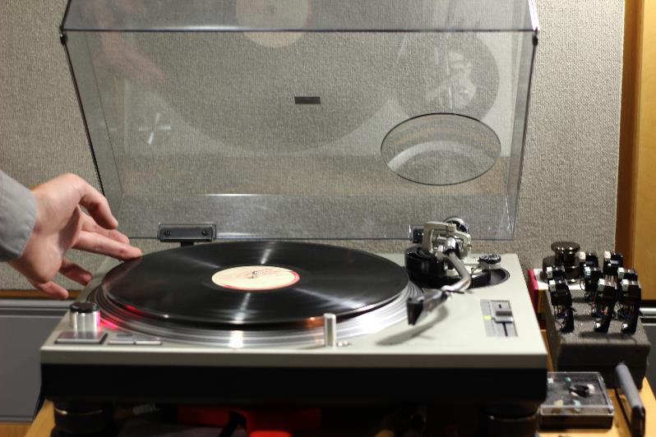
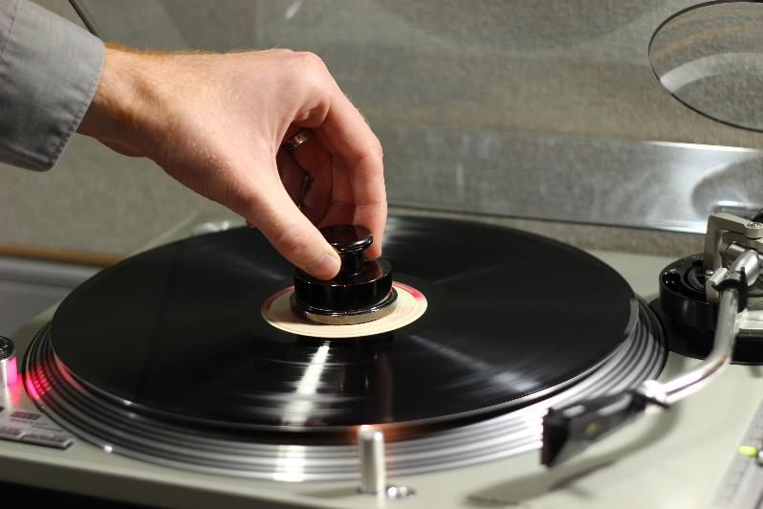
Final preparation
Notes:
Set the speed based on the disc’s label (where present) but be prepared to adjust as necessary
If the spindle hole is too large, centre the disc by gently nudging it by the rim as it spins. When you can see the grooves spin in alignment you’re in the right ballpark
Add a centre weight to reduce rumble
Dry brush of the disc.

Slide 21
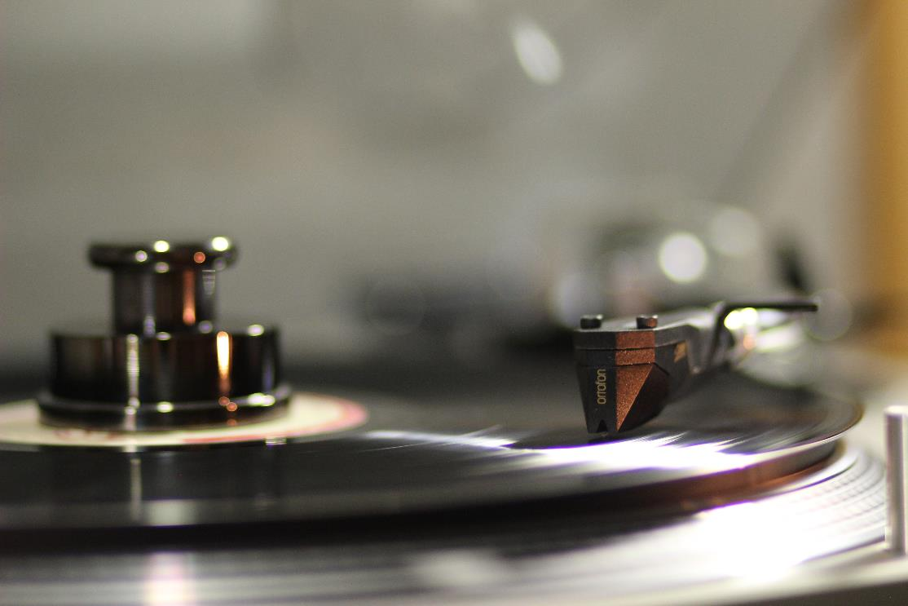
Capture
Notes:
24/96
Record in stereo even if source is mono, to capture the groove walls separately.

Slide 22
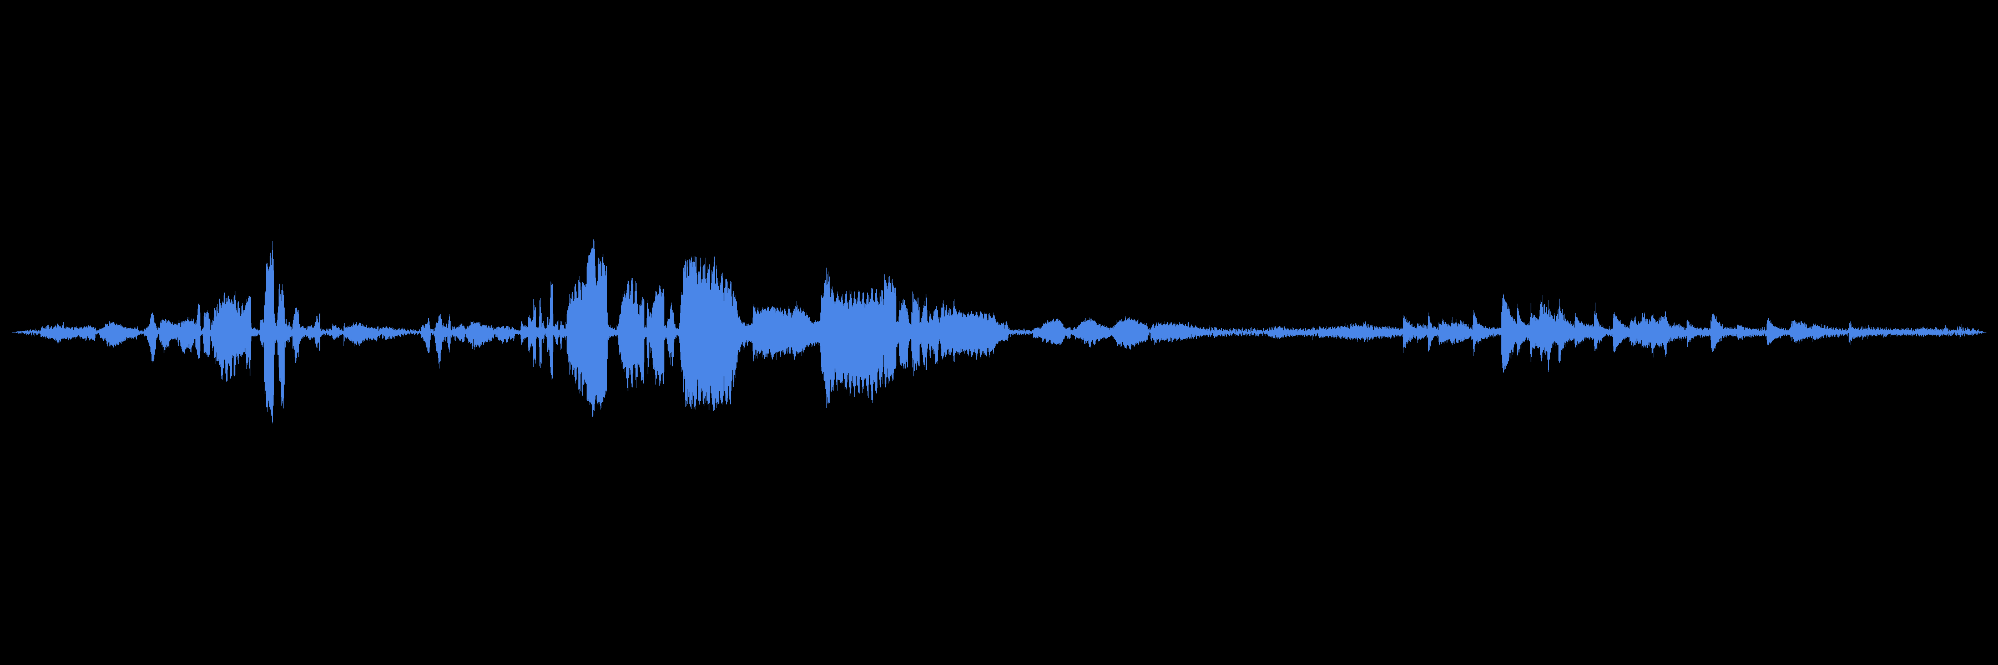
Playback
Notes:
For the purposes of public playback in our reading rooms, or for use on the British Library blog or in exhibitions, it is sometimes necessary to digitally restore the audio by performing click reduction and rolling off the surface noise. The better the initial transfer, the more likely the audio is going to respond well to such digital manipulation. Here is the final piece of audio I’m going to play from the Emilie Hooke collection. It is a 1941 coarse groove BBC lacquer, played back with a 0.7 mil elliptical microgroove stylus.

Slide 23
Further reading
Beardsley, R. and Leech-Wilkinson, D. (2009). A Brief History of Recording to ca. 1950. www.charm.rhul.ac.uk/history/p20_4_1.html
Copeland, Peter. Manual of Analogue Audio Restoration Techniques. The British Library.
Fantel, Hans. “Fabulous Phono Cartridges: 4 Channels and 50,000 Hz”. Popular Mechanics, April, 1975.
Guidelines on the Production and Preservation of Digital Audio Objects. www.iasa-web.org/tc04/audio-preservation
Lesurf, J. (2007). Around the Bend. www.audiomisc.co.uk/HFN/LP3/aroundthebend.html
Phonograph Pickup Stylus. US3774918A. Victor Company of Japan, Ltd., 1973.
Presto Instantaneous Sound Recording Equipment and Discs. New York: Presto Recording Corporation, 1940.
Street, Sean. Historical Dictionary of British Radio. Lanham: Rowman & Littlefield, 2015.

Slide 24
Thank you
Robert.Cowlin@bl.uk
@cowlin_robert

